Slide 1
OOP Final Project
Group 1
吳堃豪 許馨文 張奕奇 邱郁宸

Slide 2
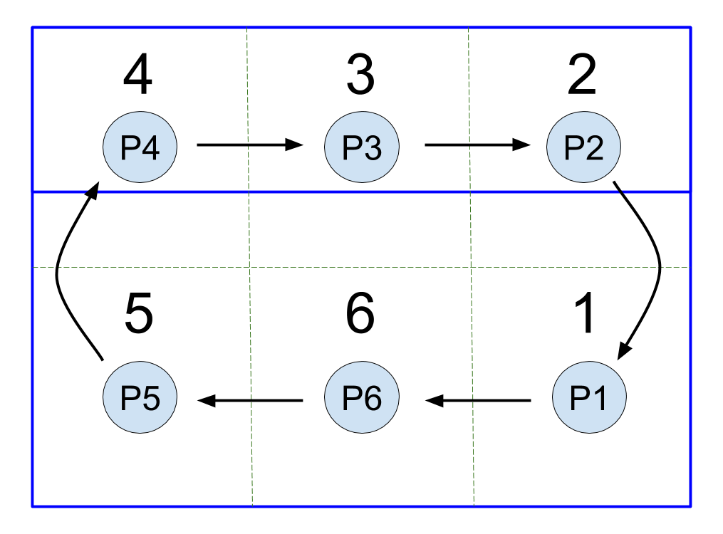
Automatic Recorder for Volleyball
Total scores
Personal scores(Block/Serve/Spike)
Timeouts
Errors
The rotation order changes by the time

Slide 3
Working Breakdown Structure(WBS)
Automatic Recorder for Volleyball
Analysis
Design
Building
Improvements and Introspections
Home/End Page
I/O Interactions
Simplify
Who’s using?
GUI overall layout
Programming Codes
Debug
Data Categories

Slide 4
Task Network/Timeline
Start
Data Categories
Who’s using?
Programming Codes
I/O interactions
許
許
張
張
邱
邱
吳
吳
3 Days
3 Days
15 Days
10 Days
Finish
Simplify
Home/End Page
GUI overall layout
Debug
吳
許
許
許
邱
張
張
吳
5 Days
3 Days
5 Days
10 Days
邱
Estimated time: around 54 days

Slide 5
Teamwork
許馨文
Data Categories
吳堃豪
Programming Codes
張奕奇
Programming Codes
邱郁宸
Data Categories
Simplify
I/O interactions
Debug
I/O interactions
GUI overall layout
Home/End Page
Who’s using?
Debug
Simplify
Who’s using?
Debug
GUI Overall layout
Home/End Page

Slide 6
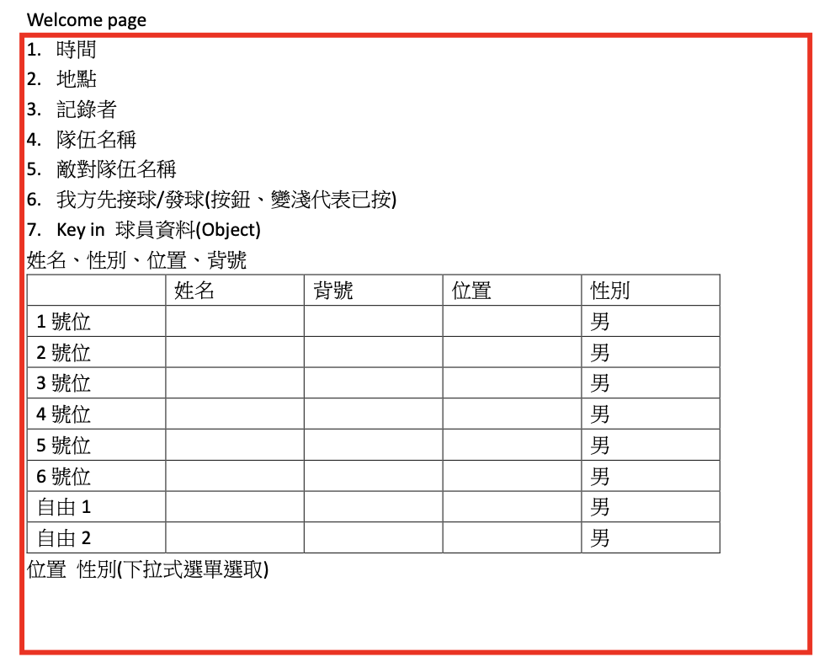
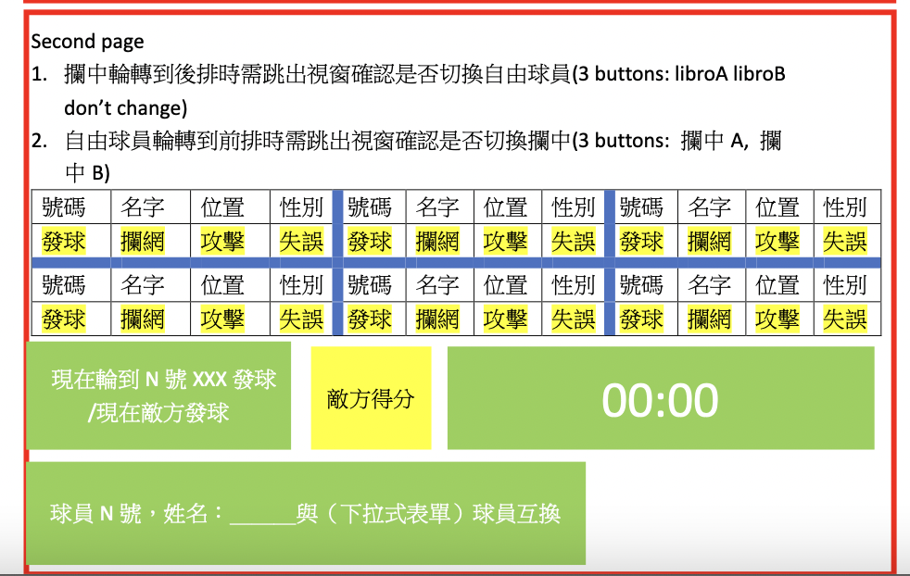
Current Progress

